Slide 1
Epilogue
See, it wasn’t that bad

Slide 2
Read Good Books

Slide 3


Slide 4


Slide 5
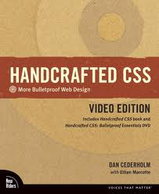

Slide 6
Follow Smart People
Jeffrey Zeldman
Ethan Marcotte
Dan Cederholm
Eric Meyer
A List Apart

Slide 7


Stuff to Do

Slide 8
The What, Why and How of Client-Side MVC Frameworks
Tomorrow at 2:15

Slide 9
This was Css for Developers
I hope you found it useful
Eric B. Sowell
Twitter: @mallioch
Web: http://ericsowell.com

